Slide 1
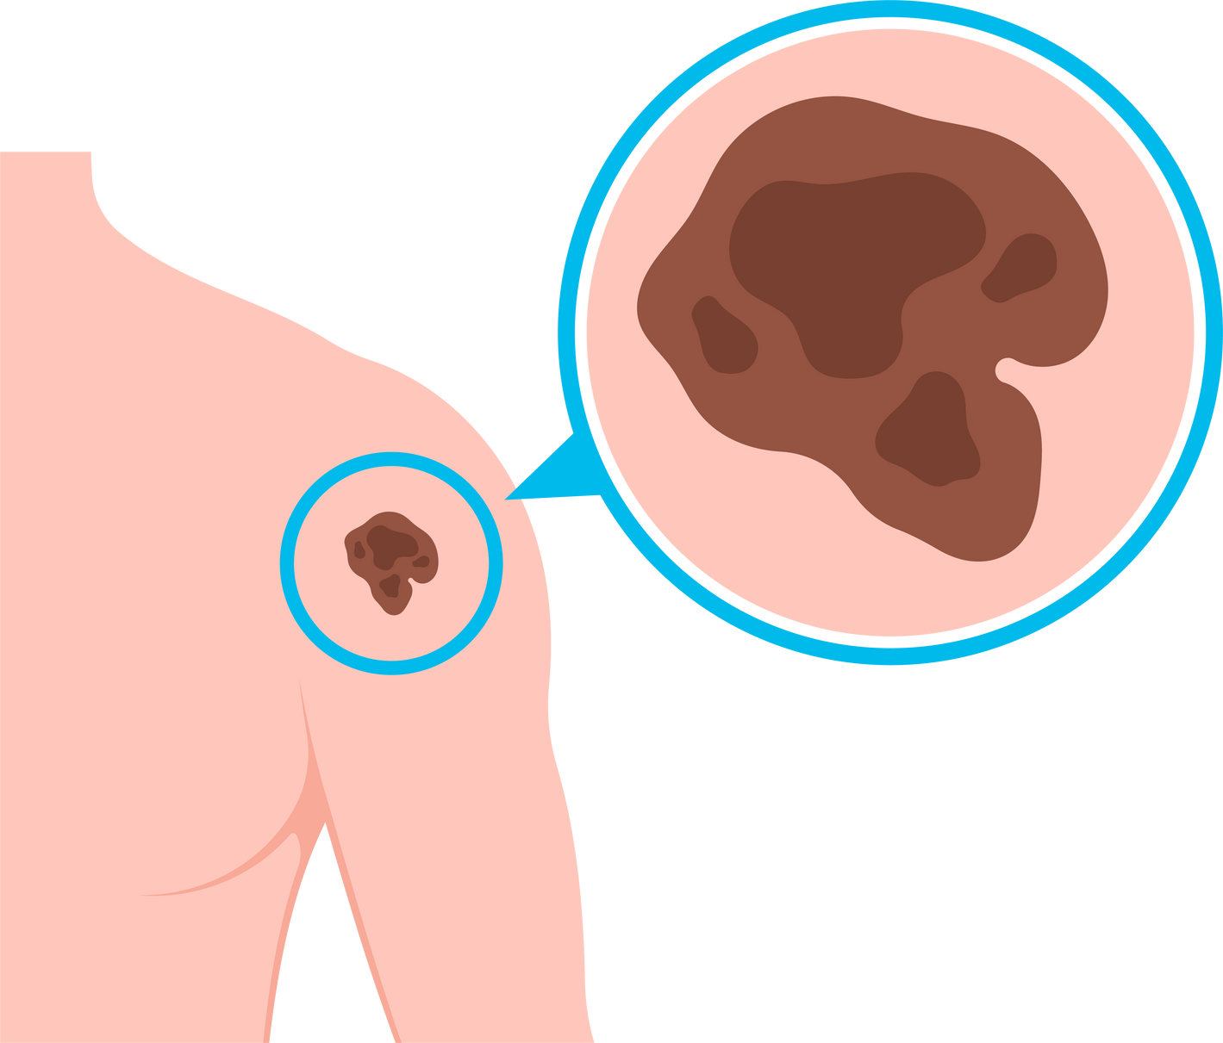


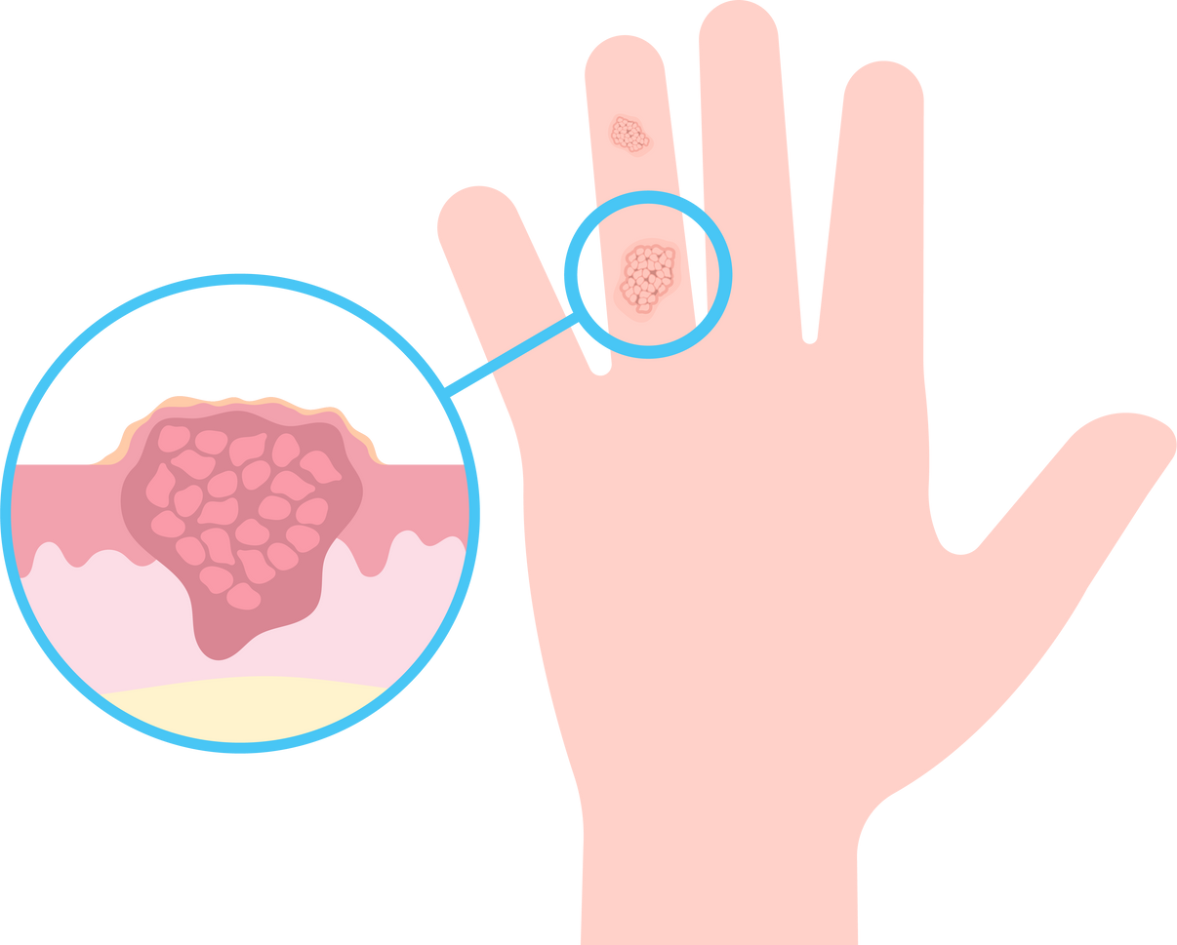

LesionLens
SKIN LESION DETECTION
#Computing4Medicine

Slide 2


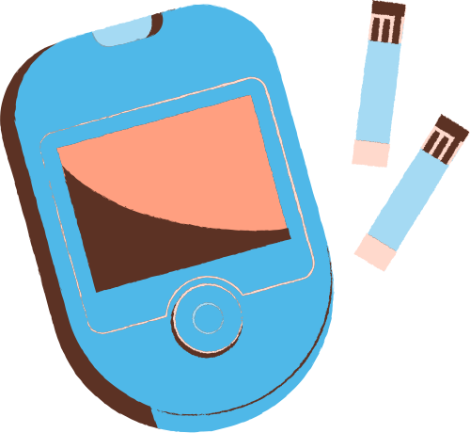


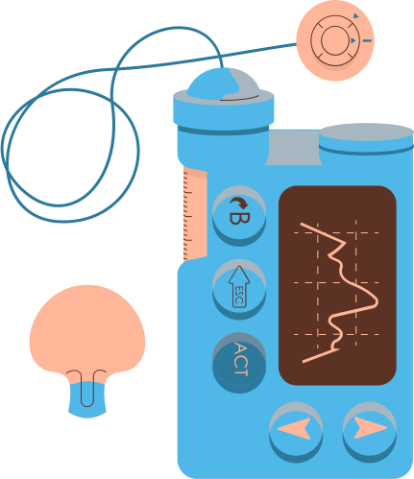
PREVIOUS TOPIC
We aimed to design and implement a comprehensive solution tailored to novice doctors and medical students undergoing practical training, helping them perform accurate diagnosis and medication on the basis of symptom analysis. Utilizing the power of computing in medicine, machine learning and data analysis, we aimed to enhance their ability to provide quality healthcare services.
STREAMLINING...

Slide 3




SKIN LESION DETECTION USING HAM10000 DATASET
Skin lesion detection using the HAM10000 (Human Against Machine with 10000 training images) dataset involves the development of a machine learning model to identify and classify skin lesions based on dermatoscopic images. The HAM10000 dataset is a collection of high-quality skin lesion images that encompass a variety of skin conditions, including melanoma, nevus, and seborrheic keratosis.

Slide 4



OVERVIEW
Dataset: The HAM10000 dataset contains images of skin lesions, along with clinical metadata such as patient age, sex, and lesion type.
Objective: The primary goal of the project is to create a skin lesion detection system capable of accurately classifying lesions into different categories, particularly distinguishing between benign and malignant lesions.
Data Preprocessing: The images in the dataset may undergo preprocessing steps such as resizing, normalization, and augmentation to enhance model generalization.
Model Architecture: Deep learning models, often based on convolutional neural networks (CNNs), are commonly employed for image classification tasks.
Training: The model is trained using a portion of the dataset, with the goal of learning patterns and features associated with different skin lesion classes. Training involves optimizing the model's parameters based on a specified loss function.
Results and Evaluation: The project's success is measured by the model's ability to accurately classify skin lesions. Performance metrics are crucial in determining how well the model generalizes to real-world scenarios and its potential for clinical application.

Slide 5
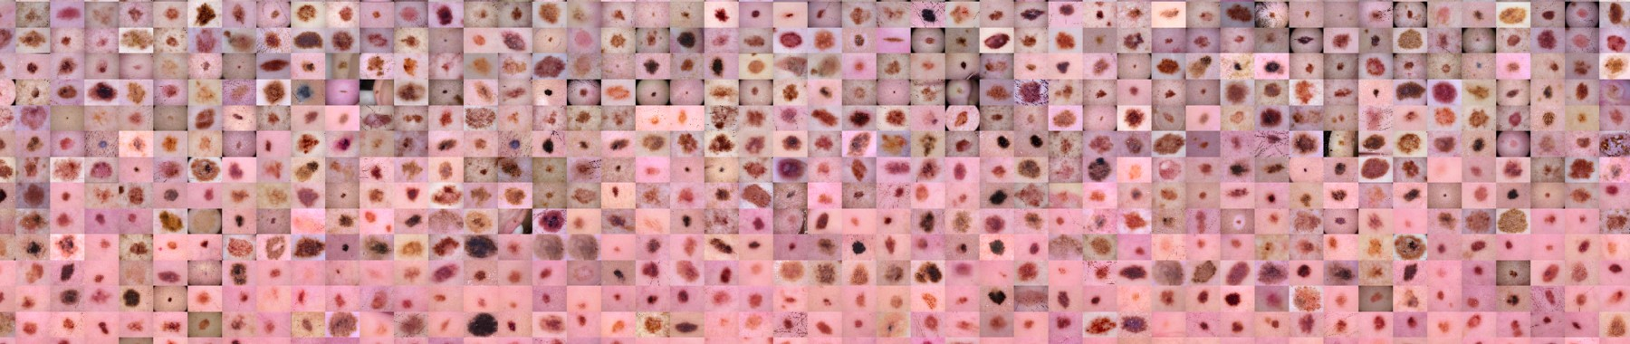
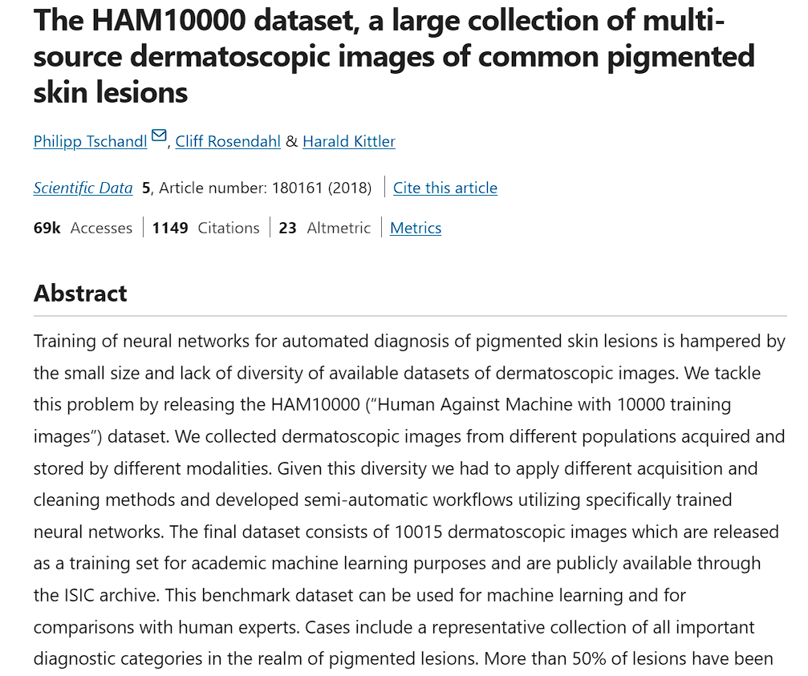
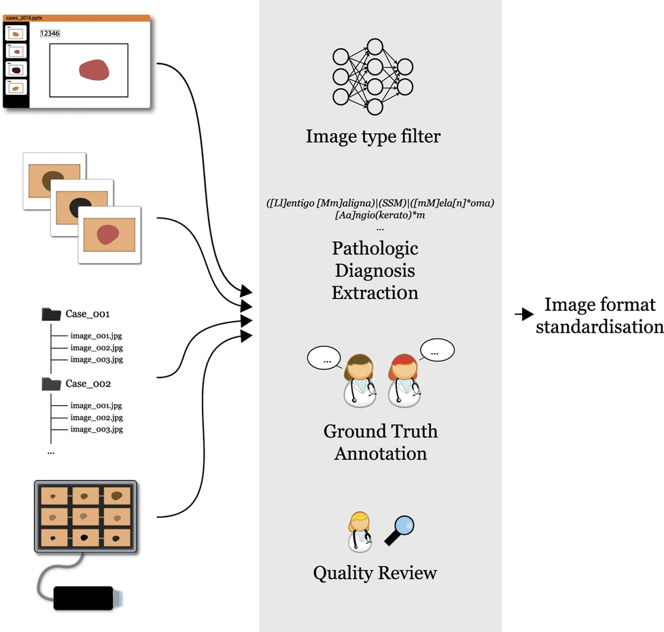
HAM10000 DATASET
Source

Slide 6
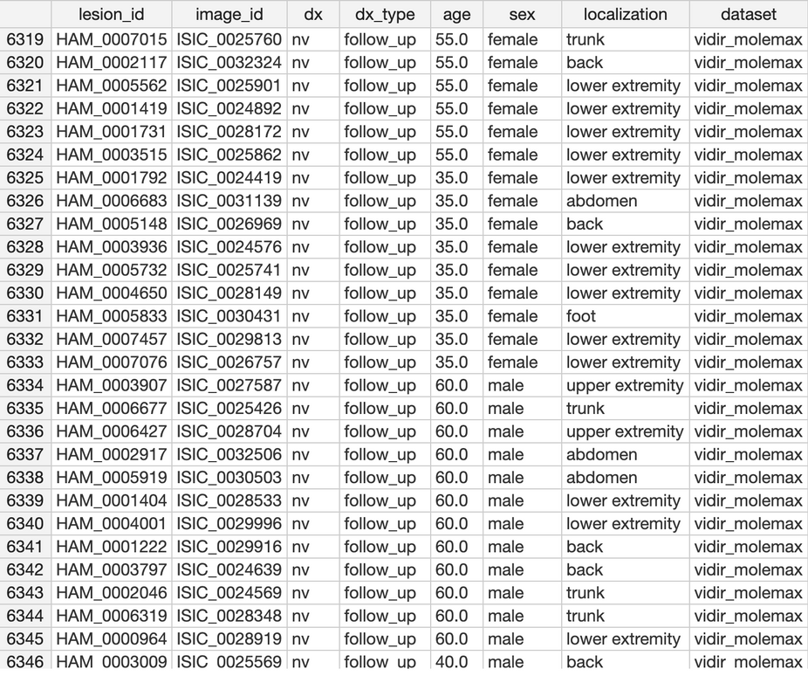
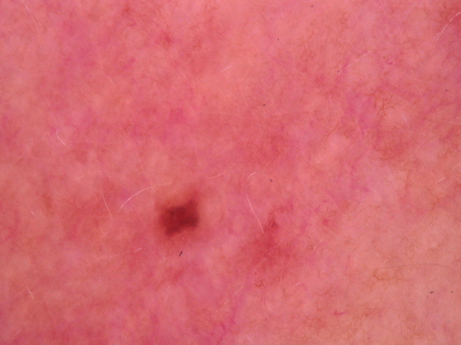
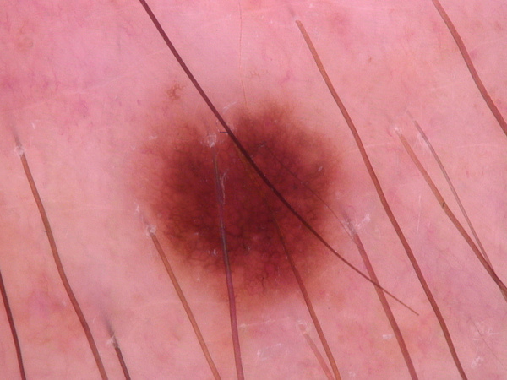
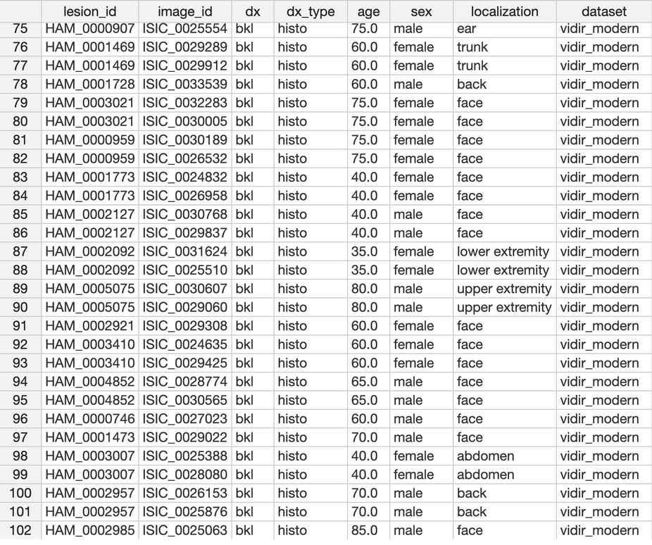
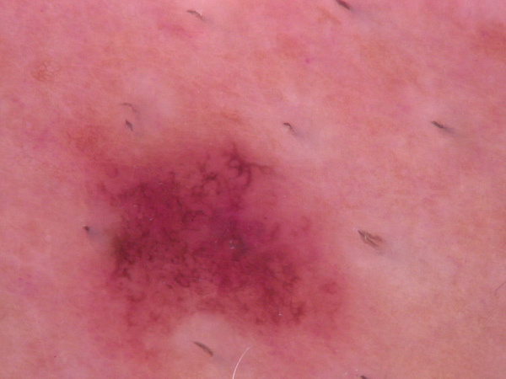
HAM10000 DATASET

Slide 7
EXPLORATORY DATA ANALYSIS
Exploratory Data Analysis (EDA) is a critical phase in the data analysis process where the primary goal is to gain insights into the structure, distribution, and characteristics of a dataset. It involves using statistical and visual methods to understand the patterns, relationships, and potential outliers within the data. EDA serves as a foundation for more advanced analyses and model building.
Key Aspects include :
Data Summarization
Univariate Analysis
Bivariate Analysis
Multivariate Analysis
Handling Missing Data
Outlier Detection
Data Visualization
Statistical Testing
Feature Engineering
Interactive Exploration

Slide 8

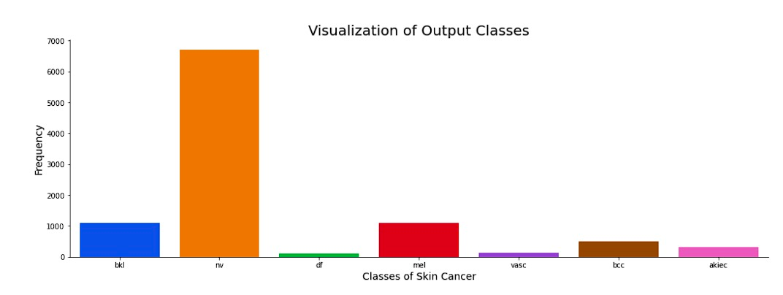
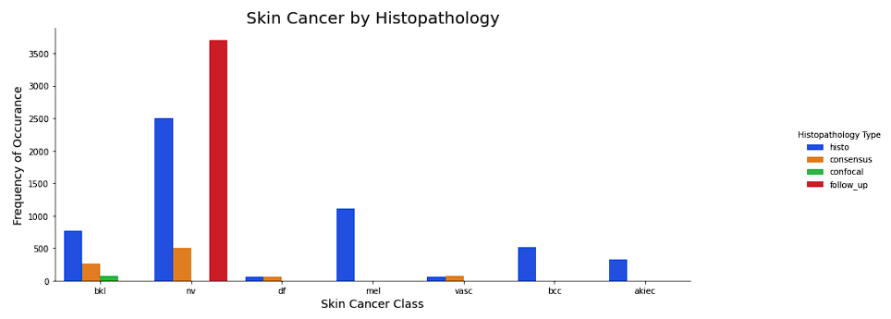
Disease chart
bkl | benign keratosis-like
nv | melanocytic nevi
df | dermatofibroma
mel | melanoma
vasc | pyogenic granulomas and hemorrhage
bcc | basal cell carcinoma
akiec | Actinic keratoses and intraepithelial carcinomae

Slide 9
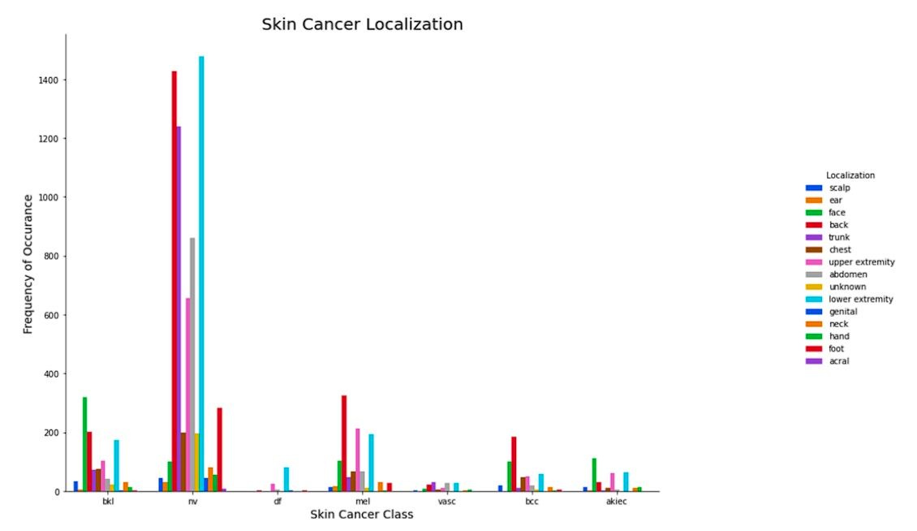
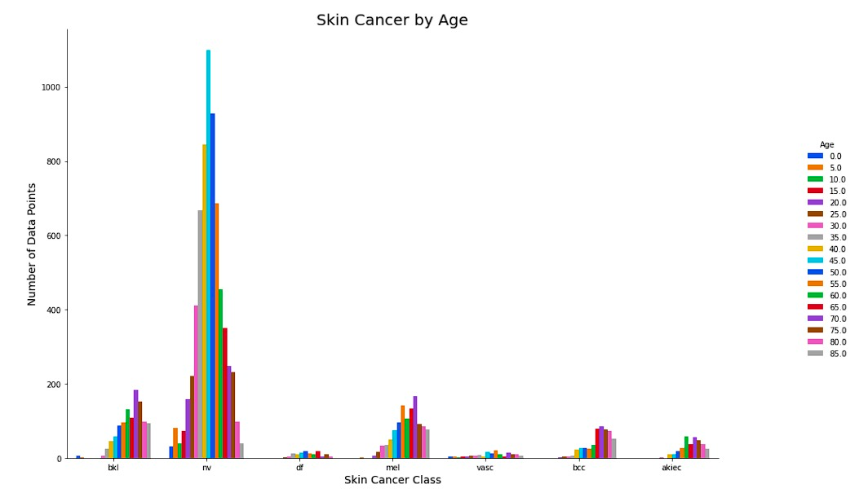

Slide 10
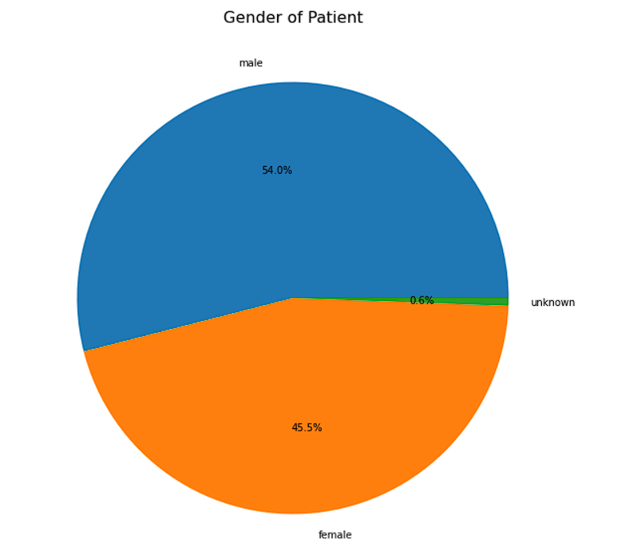
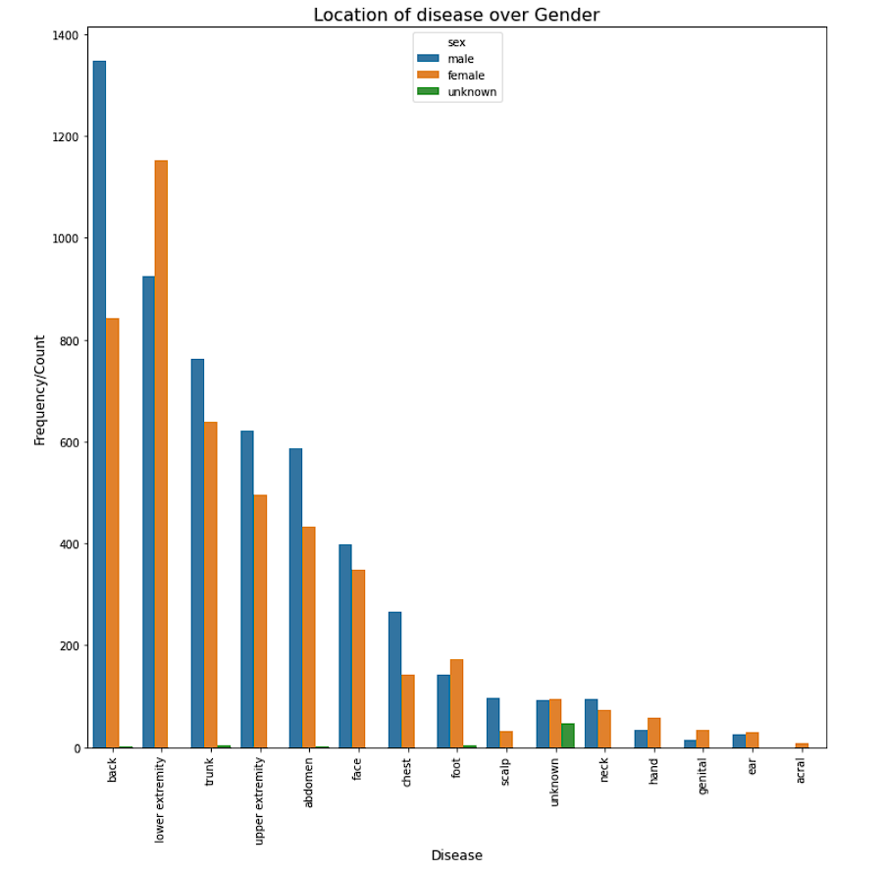
DISTRIBUTION OF DISEASE OVER GENDER

Slide 11



THANKING YOU
Aniket Malik
Dhruv Sood
Divyam Khorwal
Hardik Singh
Himanshu Shekhar
Kartik Bansal
Siddharth
PPT Link

